Slide 1
RESO SPRING CONFERENCE KICKOFF
Jeremy Crawford RESO Executive Director
Mark Lesswing
RESO Board Chair

Slide 2
Conference Sponsors
GOLD
BRONZE

Slide 3
2015 Vision & Mission
Vision: A Streamlined Real Estate Technology Industry.
Mission: To create and promote the adoption of standards that drive efficiency throughout the real estate industry.

Slide 4
Board of Directors
Mark Lesswing – Chair
Art Carter – Vice-Chair
Robert Overman – Treasurer
Richard Renton – Secretary
Chad Curry
Ethan Bailey
Mark Wise
Michael Wurzer
Justin LaJoie
Rebecca Jensen
Jeff Young
Brian Donnellan
Stuart White
Craig Cheatham

Slide 5
Staff & Operations
Jeremy Crawford – Executive Director
Greg Lemon – Certification and Compliance PM
Suzanne Biegenzahn – IMI Staff
Linda Owens – IMI Staff
Jadine Sturgill – IMI Staff
Mitch Skinner – Larson Skinner PLLC.
Robert Gottesman – Consultant
WavGroup – Marketing Consultant

Slide 6
2015 Workgroups & Committees
Data Dictionary – Rob Larson
Prop Unique ID – Paul Desormeaux
Research & Development – Paul Desormeaux
RETS 1x – Paul Stusiak
Technical Committee – Chad Curry
Transport – Scott Petronis
Marketing Committee – Jeremy Crawford
Certification Committee – Greg Lemon

Slide 7
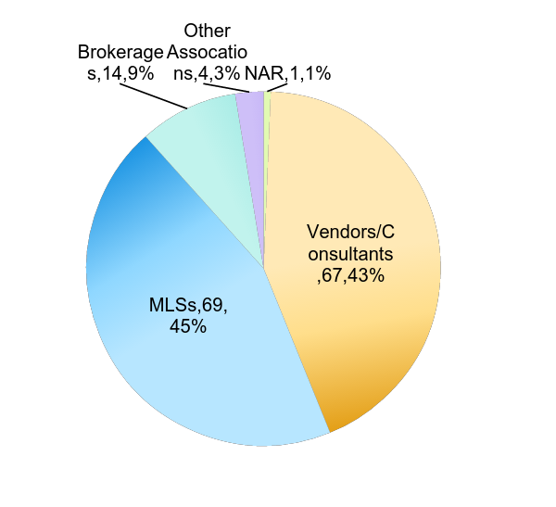
Membership
5 Membership Classifications
155 Total Members
23% Membership Growth in 2015!

Slide 8
2015 Key Strategic Initiatives
Data Dictionary Adoption & Certification
Data Dictionary 1.4
Web API
Certification Automation
Property Unique ID Standards Creation
Increase Membership
Enhance http://reso.org
Increase Industry Leadership Presence & Awareness
Continued Research & Development

Slide 9
Agenda Highlights
Business Practices & Impacts of Standards
Adoption, Compliance & Certification
Data Dictionary
Web API
RESO 2015 & Beyond

Slide 10
Jeremy Crawford RESO Executive Director
Mark Lesswing
RESO Board Chair

