Slide 1
2016 RESO FALL CONFERENCE “ACCELERATING THE REACH OF DATA STANDARDS” October 24 – 26, 2016 Nashville, TN

Slide 2
WHY DO YOU ATTEND THE RESO CONFERENCE?

Slide 3
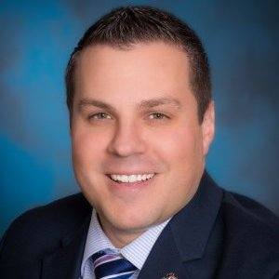
Dan Troup Technology Director at RE/Max of Michigan
“I want my voice to be heard as a broker and on behalf of my brokers. We have specific issues that deal with IDX and the REP standards and we want to make sure our voice is heard and be able to provide input.”

Slide 4
Tim Dain MLS Director at Austin Board of REALTORS
“I attend to meet the Stucco companies. I learn about products that have yet to hit the market it encourages me to think differently about the products of service we offer. It’s important that we participate to ensure the standards are developed with our input and our voice.”

Slide 5
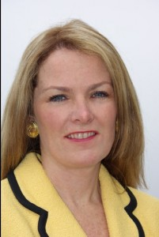
Marilyn Wilson President at RE Technology, Inc and Founding Partner WAV Group, Inc
“I love the RESO Conference and have to come! As a consultant firm, we work with many of the MLS and technology companies, and urge all of our clients to attend. It’s an amazing exchange understanding the power of real estate standards and how we can move things forward.”

Slide 6
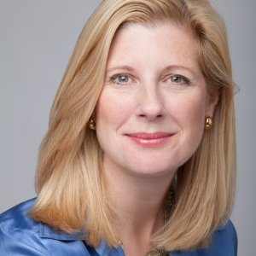
Suzanne Mueller Senior Vice President of Industry Relations at Move, Inc
“This is my first time attending a RESO Conference. Giving that it is around establishing the standards of all data in real estate. RESO’s initiative is to drive efficiencies for all parties that participate in the real- estate industry.”

Slide 7
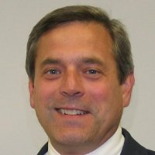
Mark Lesswing Senior Vice President & CTO, NAR
“It’s the one place you can talk to technical people and business people without being competitive and come to solutions together regarding standards.”

Slide 8
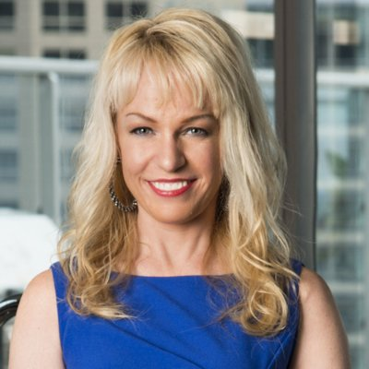
Rebecca Jensen President & CEO at Midwest Real Estate Data LLC
“I’ve been involved with RESO for a number of years. The organization has truly transformed over the past few years, due to the great work that happens at the RESO Conference. Part of the conference agenda is to discuss the standards and push them forward. The people who attend the RESO Conference are the powerhouses of the industry!”

Slide 9
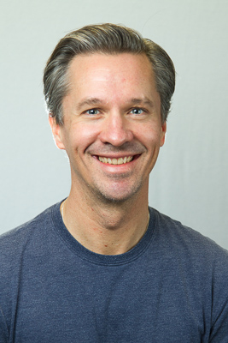
Michael Wurzer President of FBS
“Collaborating. learning and sharing with others in the industry on what the RESO organization is doing to improve the business of our partners.”

Slide 10
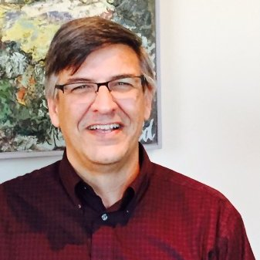
Greg Moore Vice President Technical Systems at RMLS
“Having worked in the industry for 30 years. I want to give back to the industry and the value of standards. What RESO is doing with the standards is invaluable to the industry.”

Slide 11
WHAT IS THE VALUE OF RESO TO YOUR ORGANIZATION?

Slide 12
Dan Troup Technology Director at RE/Max of Michigan
“The day to day tools that we use. Anything that touches the listing product, RESO has a hand in it. Things like the RESO data dictionary are going to make things a lot easier in the future.”

Slide 13
Marilyn Wilson President at RE Technology, Inc and Founding Partner WAV Group, Inc
“Great opportunity for Brokerages to expand their markets, go into more MLS’s and work more effective with their MLS’s and technology companies that provide services to them.”

Slide 14
Tim Dain MLS Director at Austin Board of REALTORS
“The long-term value is a faster delivery of service to the MLS user.”

Slide 15
Suzanne Mueller Senior Vice President of Industry Relations at Move, Inc
“Realtor.com gathers data from over 600 MLS’s. RESO deals with many of the pain points of drawing data from multiple sources.”

Slide 16
Mark Lesswing Senior Vice President & CTO, NAR
“Is moving standards together to bring down the cost of operation to all the players in the industry.”

Slide 17
Greg Moore Vice President Technical Systems at RMLS
“To our organization, it’s about raising the bar so we can provide a better level of service utilizing the RESO standards.”

Slide 18
Rebecca Jensen President & CEO at Midwest Real Estate Data LLC
“RESO is a collaboration across the different segments of the industry. It’s vital to understand how vendors and brokers interplay with standards.”

Slide 19
Michael Wurzer President of FBS
“It helps us compete and build a more innovative and exciting market place on a technology and business level. Gives brokers and agents access to better, constantly improving tools.”

Slide 20
WHAT IS YOUR FAVORITE PART(S) OF A RESO CONFERENCE?

Slide 21
Dan Troup Technology Director at RE/Max of Michigan
“I enjoy the sessions. However, the social aspect of talking to vendors you don’t see often is a plus. It’s great to get out with others in your industry and talk with them. That’s where good ideas come from.”

Slide 22
Marilyn Wilson President at RE Technology, Inc and Founding Partner WAV Group, Inc
“RESO workgroups are really interesting. It’s a true democracy so you really watch the process of shaping the different parts of the standards. It’s all really neat!”

Slide 23
Tim Dain MLS Director at Austin Board of REALTORS
“RESO is unique because you get a lot of product people in the same space.”

Slide 24
Suzanne Mueller Senior Vice President of Industry Relations at Move, Inc
“Enjoyed connections made. More networking within the industry among all parties involved.”

Slide 25
Mark Lesswing Senior Vice President & CTO, NAR
“My favorite part of the RESO conference is the show & tell. Presenters explain what they personally value and where they see the industry going.”

Slide 26
Greg Moore Vice President Technical Systems at RMLS
“Working on best practices with CMLS. Matching up beyond RESO to ensure the standards are used in the best way. Education as well as technology.”

Slide 27
Rebecca Jensen President & CEO at Midwest Real Estate Data LLC
“The people are brilliant! They are truly making a difference in the industry everyday. I get to listen in and ask questions. I learn a tremendous amount about the products.”

Slide 28
Michael Wurzer President of FBS
“Interacting with the different people. It’s such a vibrant community to network with.”

Slide 29
WHO ELSE SHOULD COME TO A RESO CONFERENCE?

Slide 30
Dan Troup Technology Director at RE/Max of Michigan
“I would love to see more brokers attend and get their feedback.”

Slide 31
Tim Dain MLS Director at Austin Board of REALTORS
“Anyone involved with products delivered to the agents, brokers or MLS’s. It would be nice to see the more established product vendors involved”.

Slide 32
Marilyn Wilson President at RE Technology, Inc and Founding Partner WAV Group, Inc
“Anyone orchestrating technology for a brokerage or on behalf of a brokerage absolutely has to be here.”

Slide 33
Suzanne Mueller Senior Vice President of Industry Relations at Move, Inc
“If you are participating in the real estate industry in any way that uses data, you need to be here.”

Slide 34
Mark Lesswing Senior Vice President & CTO, NAR
“Business operators. They can understand how standards help with business process.”

Slide 35
Rebecca Jensen President & CEO at Midwest Real Estate Data LLC
“RESO is important for everyone in the industry, but I would give a special emphasis to brokers.”

Slide 36
Michael Wurzer President of FBS
“Getting technology folks from all the participants would be great. From title companies, appraisal firms. The more areas of the transaction we can cover, the better.”

Slide 37
Greg Moore Vice President Technical Systems at RMLS
“Thrilled to see brokers here. However, the addition of those in appraisal would be an added benefit.”

Slide 38
CLOSING REMARKS

Slide 39
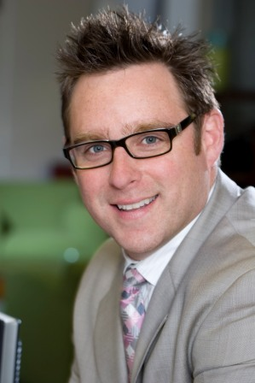
Jeremy Crawford RESO CEO
“This has been a record setting event with over 330 registrations. We’ve had workgroups lead by powerhouses in the industry, and received amazing testimonials from all areas of the industry. From technology companies, brokers and MLS’s. Onsite workgroups have been standing room only. We sold out this year, and plan to do the same next. We look forward to seeing you in 2017!”

